Slide 1
EMPLOYEE DATA ANALYSIS USING EXCEL
NAME : ANANDHI S
REGISTER NO : 312206352,unm299bcom(g)05 DEPARTMENT : B.COM ( GENERAL)
COLLEGE: SSKV COLLEGE OF ARTS AND SCIENCE FOR WOMEN

Slide 2

PROJECT TITLE
EMPLOYEE DATA ANALYSIS USING EXCEL

Slide 3

AGENDA
Problem Statement
Project Overview
End Users
Our Solution and Proposition
Dataset Description
Modelling Approach
Results and Discussion
Conclusion

Slide 4

PROBLEM STATEMENT
Track employee performance rating overtime
Identify top performers and underperformers
Analyze performance by department, job role, and other categories
Visualize trends and correlations in performance data
Enable filtering and drill-down capabilities for in-depth analysis

Slide 5
PROJECT OVERVIEW
Effective employee performance management is crucial for organizations to achieve their goals and objectives.
This project will involve collecting and cleaning employee performance data, designing and developing an interactive Excel dashboard, and creating a user guide and data dictionary for easy adoption.

Slide 6
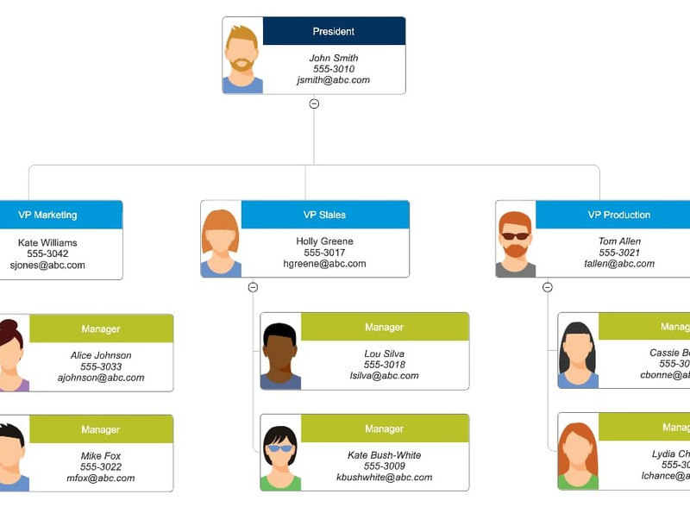

WHO ARE THE END USERS ?
HR Managers Department Heads Team Leads
Line Managers Talent Management Business Analysts Executives

Slide 7

OUR SOLUTION AND
ITS VALUE PROPOSITION
Conditional formatting – mission Filter-Remove
Formula – performance
Pivot-summary
Graph-data visualization
Conditional formatting: Our Excel based Employee performance Analysis Solution utilizes Conditional formatting to provide a clear and intuitive visualization of Employee performance data.

Slide 8
Filter – Remove: By incorporating filtering and removal capabilities, our solution empowers HR managers and leaders to efficiently analyze and visualize employee performance data, driving informed decision-making and business success.
Formula – performance: By leveraging formulas and performance metrics in Excel, our solution provides a powerful and efficient tool for employee performance analysis enabling HR managers and leaders to make informed decisions and drive business success.

Slide 9
Pivot- summary: By leveraging pivot tables and summary reports in Excel, our solution provides a powerful and flexible tool for employee performance analysis, enabling HR managers and leaders to Make informed decisions and drive business success.
Graph-data visualization: By leveraging graphs and data visualization in excel our solution provides a powerful and intuitive tool for employee performance analysis, enabling HR managers and leaders to Make informed decisions and drive business success.

Slide 10

DATASET DESCRIPTION
Employee=kaggle 26-features
9-features
Emp id-num Name-text Name-text Emp type
Performance level
Gender- male female Employee rating-num
{}

Slide 11

THE “WOW” IN OUR SOLUTION
Performance level: =IFS(Z4>=5,"VERY HIGH",Z4>=4,"HIGH",Z4>=3,"MED",TRUE,"LOW")

Slide 12
MODELLING
Data collection 1)kaggale
Search employment performance dataset
Then download Employmen data
Feature collection
Feature identify
colour filled blank values
Data cleaning
Missing values identify
Missing values filterout

Slide 13
Performance level 1)Calculate performance level
2)Using formula
summary
open pivot table.
drag rows,cols,filters,values respectively businessunit,performance level, gender code, count of first name.
remove the blank option.
visulazation
put recommended graph
filterout the linear and exponential features
To get pie chart for our reference.

Slide 14




RESULT
HIGH
LOW
MED
VERY HIGH
120.0
100.0
80.0
60.0
40.0
20.0
0.0
BPC
CCDR
EW
MSC
NEL
PL
PYZ
SVG
TNS
WBL

Slide 15
RESULT

Slide 16
CONCLUSION
Analyzing the employment performance dataset provides valuable insights into employee productivity,efficiency,and overall contribution to organizational goals.
Graphs play a crucial role in visualizing the data and useful for comparing individual employee performances.

